Slide 1


Business
Analysis

Slide 2
Introduction And Objective
Zomato's recent efforts to create new restaurants are motivated by a strategic goal of improving its food delivery and dining environment. The company has created many tools and platforms to help restaurant partners make data-driven decisions, including the Zomato Food Trends platform. This platform delivers useful information on client preferences, optimal pricing, and trending cuisines, allowing restaurants to better align their products with market demands.
Objective
Analyze existing data on food industry
Draw insights From current trend and sentiment of food industry
Understand trending data and visualize investment in new restaurants opening strategy

Slide 3
Problem Statement :
Zomato is looking to expand and open new restaurants. What strategies and suggestions can help Zomato identify the best locations and opportunities for opening new restaurants? How can data be analyzed to ensure informed decision-making and maximize the success of their expansion plans?

Slide 4
Data Overview
Restaurant ID: Unique identifier for each restaurant.
Restaurant Name: The name of the restaurant.
Country Code: Country code of the location where the restaurant is situated.
City: The city where the restaurant is located.
Address: The specific address of the restaurant.
Locality: The locality where the restaurant is situated.
Locality Verbose: Detailed information about the locality.
Longitude: The geographical longitude coordinate of the restaurant.
Latitude: The geographical latitude coordinate of the restaurant.
New Cuisines: The type of cuisine offered by the restaurant.
Currency: The currency used for transactions in the restaurant.
Has_Table_booking: Indicates whether the restaurant has a table booking option (Yes/No).
Has_Table_booking: Indicates whether the restaurant has a table booking option (Yes/No).
Has_Online_delivery: Indicates whether the restaurant offers online delivery (Yes/No).
Is_delivering_now: Indicates whether the restaurant is currently delivering (Yes/No).
Switch_to_order_menu: Indicates whether users can switch to the order menu (Yes/No).
Price_range: A numeric value indicating the price range category of the restaurant.
Votes: The number of votes or ratings/(feedback) received by the restaurant.
Average_Cost_for_two(Indian rupees):The average cost for two people dining at the restaurant
Rating: The overall rating of the restaurant is based on user reviews.
New_Datekey_opening: The date when the restaurant was opened.
Country: Country where the Restaurant is located

Slide 5

Data Cleaning and Processing
Sort the data by ascending the Order by ID
Changed the Date_key to a proper date formate
Used appropriate LOOKUP functions to fetch the country.
Treated the missing values of cuisines from USA.
Processed different currencies and converted into INR (for comparisons).
Build an dynamic table which will be connected to the Raw Data so that any changes made in the original data will get reflected in the dynamic table as well as in the Dashboard.

Slide 6

Methodology
Missing value treatment:- Using power query editor, pivot table, VLOOKUP functions, .
Data Enrichment:- Enhanced the data set with additional variables using VLOOKUP, MID, SEARCH, CONCAT, and connecting tables to cross reference with original data source.
Descriptive Analysis:- Employed Pivot tables for summarizing key metrices, conditional aggregational functions and normal excel functions (count, if, etc.) for analyzing objective questions.
Trend Analysis:- Analyzed the trend between ratings of Restaurant trendlines.
Executive Segmentations:- Applied year and country wise filters to analyse the various outcomes of ratings, prices etc. for different countries at a different timeline.
Data Visualization:- Created dynamic charts and Dashboard for data representation, enabling interactive data exploration.

Slide 7
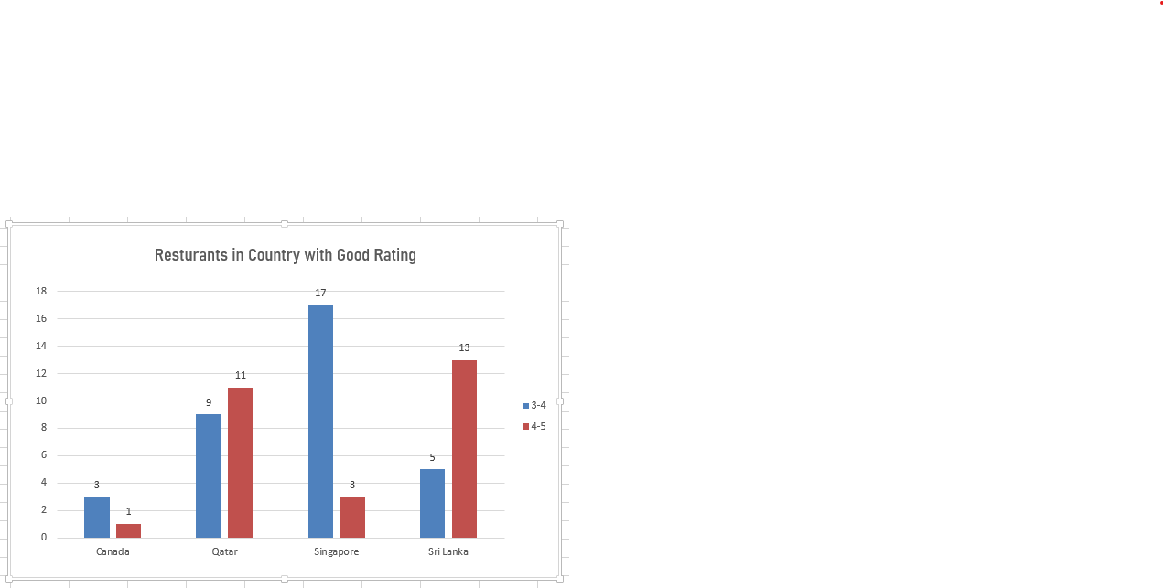
Analysis of Objective Questions
The number of restaurants opened in each country
With 20 restaurants, Qatar has the most restaurants overall. With 18 restaurants, Singapore and Sri Lanka are in second place. The number of restaurants in each of the dataset's countries is shown in the chart. Canada has four restaurants, which is the fewest of any country.

Slide 8
SUGGESTIONS :
Countries with the fewest restaurants present a good opportunity for opening new ones.
Providing high-quality service is crucial for success in these markets.
These markets are ideal for offering customers a fresh and unique dining experience.
Existing restaurants in these countries have very high ratings.
Introducing online delivery services can enhance customer satisfaction.
The identified countries include Canada, Sri Lanka, Qatar, and Singapore.

Slide 9

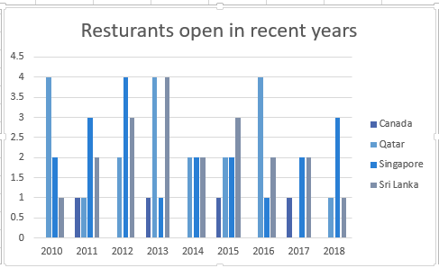
The number of restaurants opened each year
The suggested countries have a maximum of 4 restaurants currently open.
The minimum number of restaurants in these countries is 1.
These countries show low restaurant growth, indicating good business opportunities for expansion.

Slide 10
SUGGESTIONS :
A limited number of new restaurants were opened in the past year in the analyzed countries.
The countries mentioned are Canada, Sri Lanka, Qatar, and Singapore.
The low number of new restaurant openings indicates a low level of competition in these markets.
The market in these countries is less saturated, providing opportunities for new businesses.
Due to the low competition, these markets offer a great opportunity for new restaurant ventures.
The limited number of new openings suggests that the restaurant market is still in its growth phase.

Slide 11
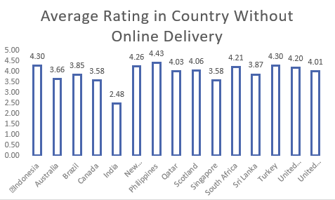
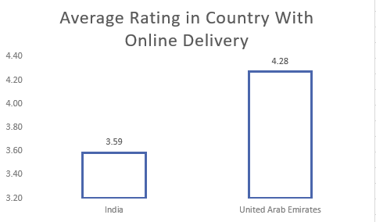
Does online delivery and Table booking has impact on customer satisfaction ?
The data reveals that countries without online delivery and table booking services have an average rating of 2.68, while those offering both services achieve a higher average rating of 3.60. This clearly indicates that providing online delivery and table booking significantly impacts customer satisfaction

Slide 12
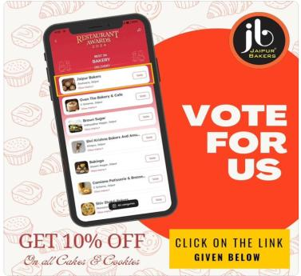
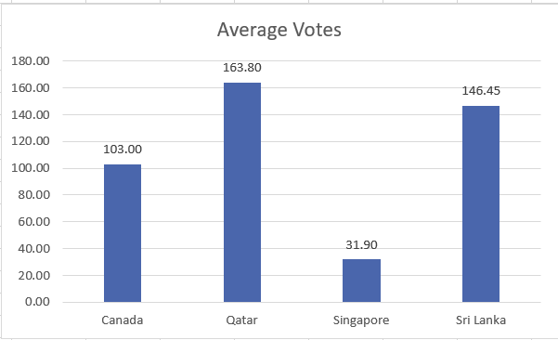
The average number of voters for the restaurants in each country
Qatar is having the highest number of voters in restaurants, followed by Sri lanka, Canada AND Singapore
People are voting least in the Singapore .

Slide 13
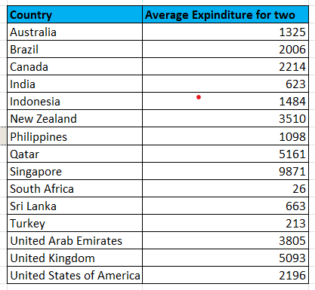
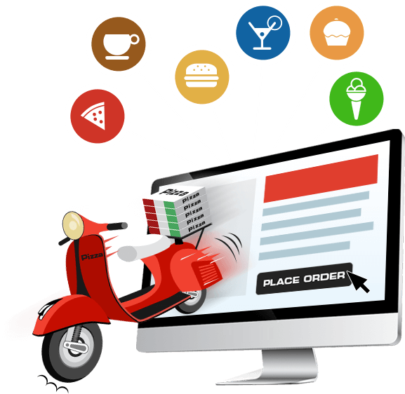

The current expenditure on food in the suggested countries In Indian rupees ?
Does online delivery and Table booking has impact on customer satisfaction ?
The data reveals that countries without online delivery and table booking services have an average rating of 2.68, while those offering both services achieve a higher average rating of 3.60. This clearly indicates that providing online delivery and table booking significantly impacts customer satisfaction

Slide 14
DATA OVERVIEW
1. Number of Restaurants:
Qatar has the highest number of restaurants with 20.
Singapore and Sri Lanka both have 18 restaurants, making them second in the ranking.
Canada has the fewest number of restaurants with 4.
2. Expansion Opportunities:
Suggested countries for restaurant expansion have a maximum of 4 restaurants currently.
The minimum number of restaurants in these countries is 1.
These countries show low restaurant growth, indicating promising opportunities for expansion.
3. Impact of Online Delivery and Table Booking:
Countries without online delivery and table booking services have an average rating of 2.68.
Countries with both services have a significantly higher average rating of 3.60.
This suggests that offering online delivery and table booking positively impacts customer satisfaction.
4. Voter Participation:
Qatar has the most voters for restaurants, followed by Sri Lanka, Canada, and Singapore.
Singapore has the least voter participation among the mentioned countries.

Slide 15
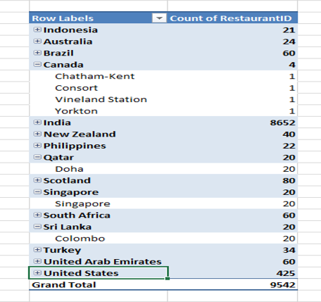
The cities in the recommended country for business expansion
Canada: Chatham-Kent, Vineland Station, Yorkton, Consort
Sri Lanka : Colombo
Qatar : Doha
Singapore : Singapore

Slide 16
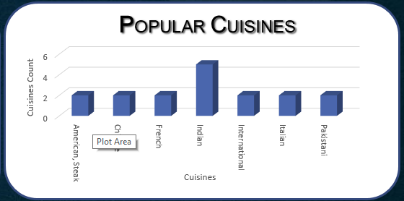
Popular Cuisines in the suggested countries
In addition to offering regional cuisine, we can introduce popular international dishes like :
American, Steak
Chinese
French
Indian
International
Italian
Pakistani

Slide 17
Recommendation
Zomato should focus on building stronger relationships with restaurants in specific regions.
Offering exclusive deals and marketing support can encourage more restaurants to participate on the platform.
Zomato can implement targeted promotions to attract more customers and increase order frequency.
These coupons and offers can be customized for specific demographics, regions, or types of restaurants.
Zomato should focus on optimizing restaurant menus by offering unique and high-quality items.
Instead of inflating prices, Zomato should focus on offering value through premium items and sustainable pricing strategies.
Using cross-selling and upselling techniques can enhance profitability without solely relying on price increases.

Slide 18
SUMMARY
Zomato should focus on building stronger partnerships with restaurants by offering exclusive deals, marketing support, and incentives to encourage participation. It can also attract more customers and increase order frequency by launching targeted coupons and offers, tailored to specific demographics and regions. Instead of raising prices in monopolistic markets, Zomato should optimize menus with unique, high-quality items and employ cross-selling and upselling strategies to enhance profitability without causing customer dissatisfaction.

Slide 19
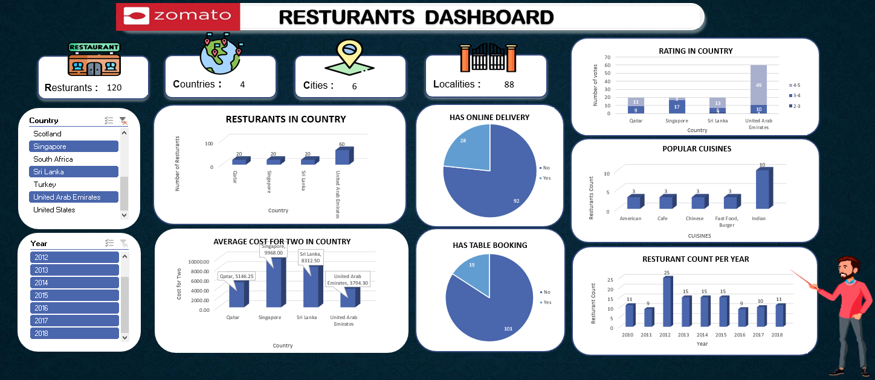
Dashboard

Slide 20


